Slide 1
Organizing User Search History
Submitted to : Keith Maull ((proffesor)
By :
Group #13 from Section #2
Anitha Rani Suram (999990999)
Praveen Chowdary Kommalapati (999991582)
Sudhir Kumar Pallikonda (999990561)

Slide 2
Contents
Introduction
Abstract
Existing System
Proposed System
Algorithms
Modules
UML Diagrams
Output screen shots
System configuration
References

Slide 3
Introduction
Data Mining is the process of extracting information from the data and therefore we call it as Knowledge Discovery In Data.
Data Mining is also a practice of automatically searching large stores of data to discover patterns and trends that go beyond simple analysis.

Slide 4
ABSTRACT
As the advantages with Web goes on increasing day by day, the users gets increased and their dependency gets increased too. Moreover user always pay attention to the Web when they get perfect results with less time span.
Here our aim in this project is to provide best and quick results for the users based on their search history.

Slide 5
Existing System
It may have undesirable effects of changing a user’s existing query group, potentially undoing the user’s manual efforts in organizing their history.
Requires repetition of large number of query group similarity computations for each and every command.
Disadvantages :
More expensive
Time consuming
Not a good user friendly

Slide 6
Proposed System
It finds how signals generated from search logs such as query reformulations and clicks can be used together to determine the relevance among the query groups.
Our goal is to ensure good performance by avoiding the disruption of existing user defined query groups.

Slide 7
ALGORITHMS
1. Page Rank Algorithm :
It is used to determine how likely a person is clicking on some links to reach a particular page he want.
2. EM Algorithm :
It is used for Query Group creation by finding the maximum likelihood estimates of parameters and it will be done in two steps as below.
E-step : Creates functions for exceptions for current estimates.
M-step : Computes the parameters maximizing the excepted log likelihood found on the E-step.

Slide 8
Modules
Query group is a relevance measure that captures the user search parameters like textual content of the query and time interval between them.
Search history is a collection of queries by the users which are relevant to each other with some common informational need.
Query relevance and Search logs provides an environment of giving the information before you complete your query based on your search data
Dynamic query grouping treats every query as a singleton query and finally merges all the singleton queries as an alternative fashion.

Slide 9
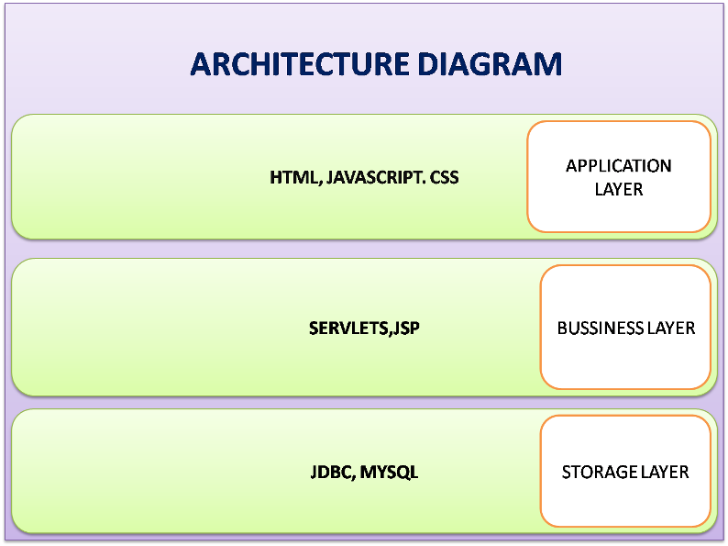
Architecture Diagram

Slide 10
UML Diagrams
Use case diagram
Class diagram
Sequence diagram
Activity diagram
Component diagram
State chart diagram
Object diagram
Deployment diagram

Slide 11
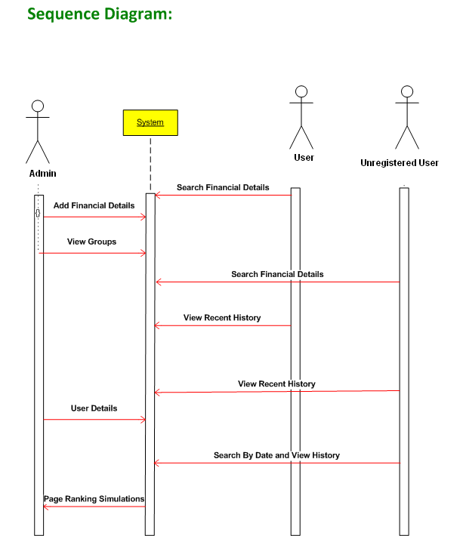
Use case, Class, Sequence and Activity Diagrams

Slide 12
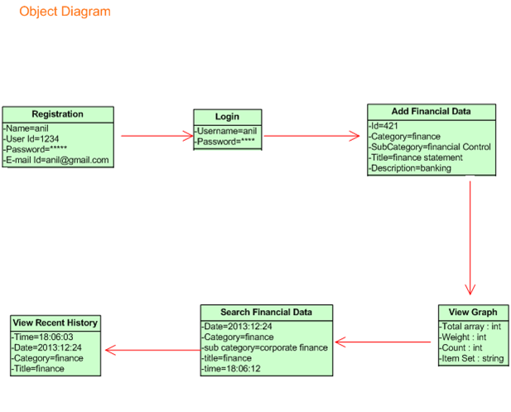
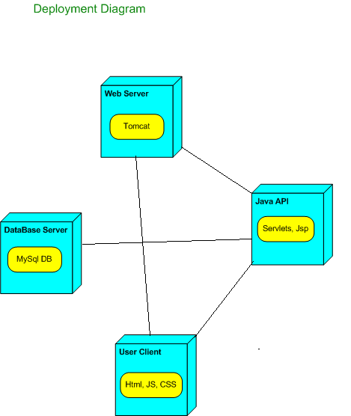
Component , State Chart, Object and Deployment Diagrams

Slide 13
Collaboration Diagram

Slide 14
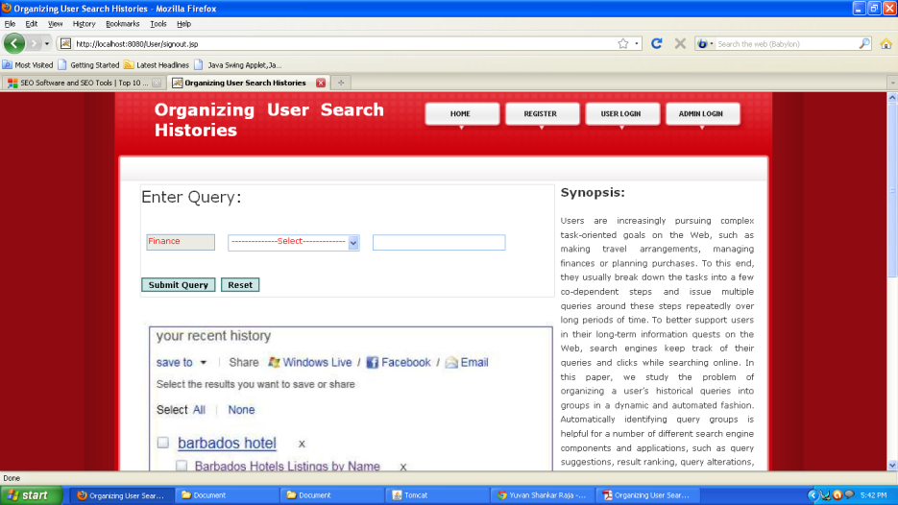
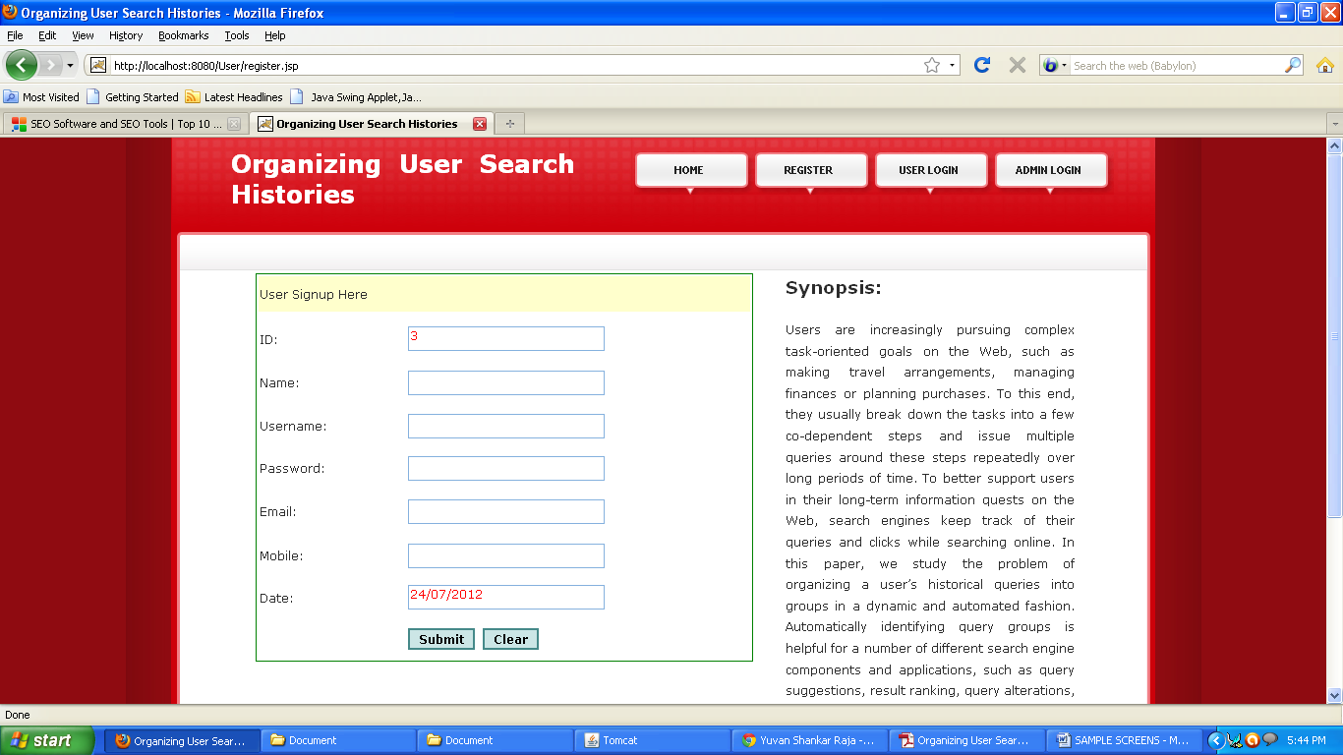
Screen shots for output
Welcome page
User registration page

Slide 15
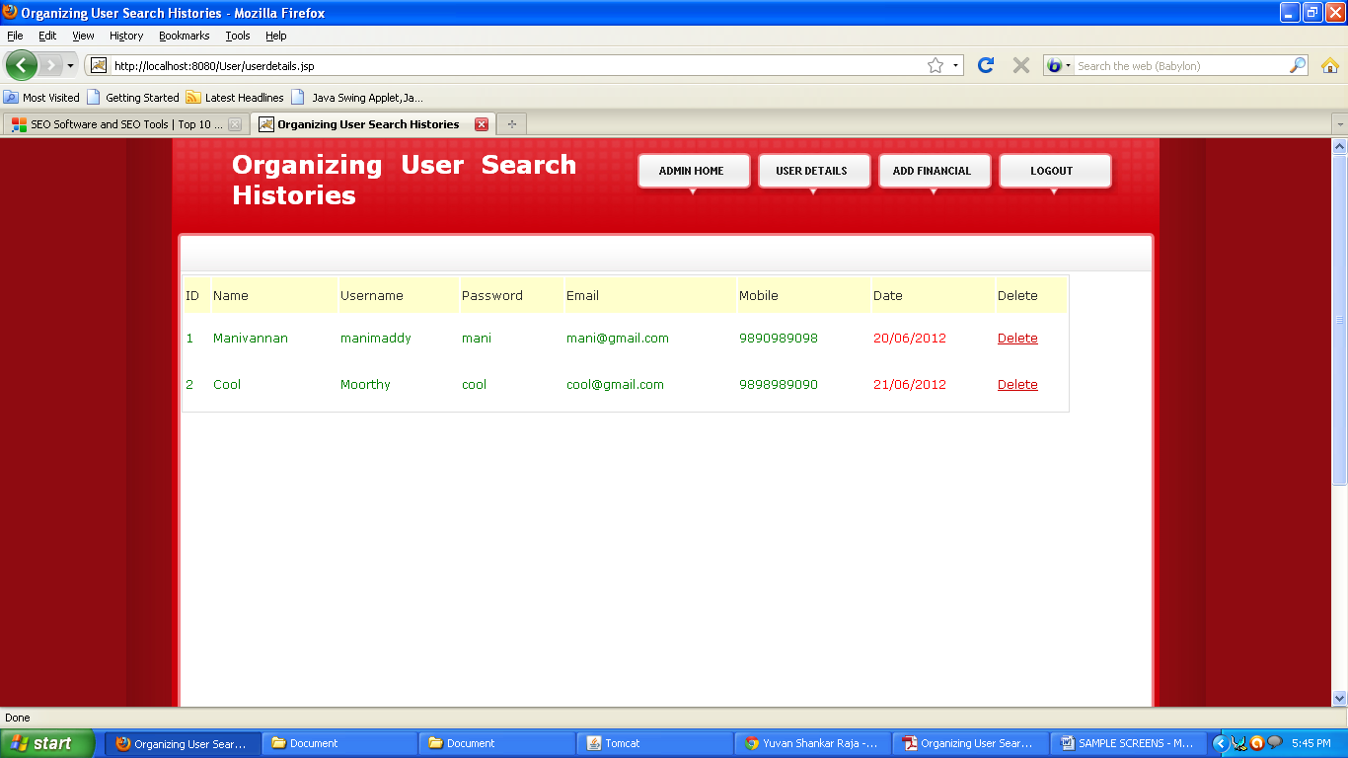
Pattern recognization
User details
Search history by date

Slide 16
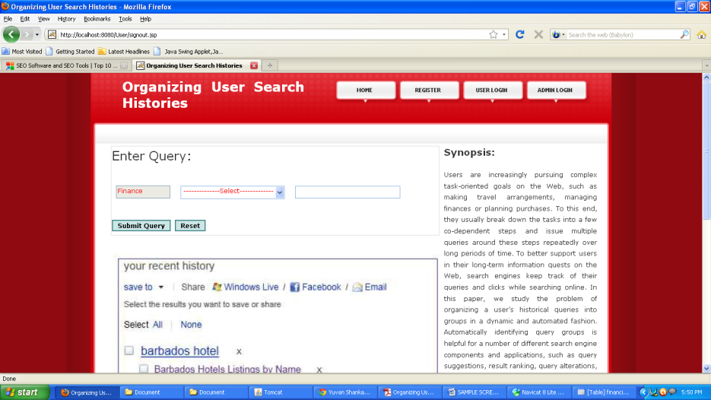
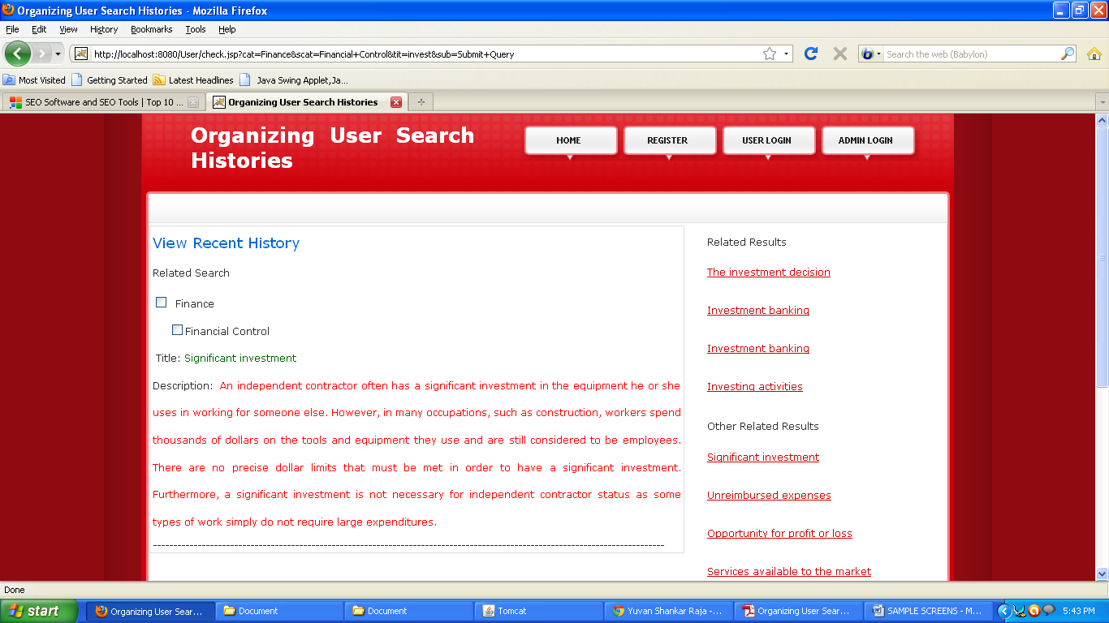
Example
Guest Search Query about Financial:
Related result

Slide 17
System configuration
H/W System Configuration:-
Processor - Pentium –IV
RAM - 512 MB
Hard Disk - 80 GB
S/W System Configuration:-
Operating System : Windows 2000/XP
Application Server : Tomcat5.0/6.X
Front End : HTML, Java, JSP,AJAX
Scripts : JavaScript.
Server side Script : Java Server Pages.
Database Connectivity : MYSQL.

Slide 18
References
J. Tee van, E. Adar, R. Jones, and M. A. S. Potts, “Information retrieval:
A. Spink, M. Park, B. J. Jansen, and J. Pedersen, “Multitasking during Web search sessions

Slide 19
Thank you…!

